Slide 1
Analyzing Classes of Rainfall in Koforidua (1980-2020): Impacts, Trends, and Sustainable Planning.
Danyal Hamza
10944646
SUPERVISOR: DR. ABRAHAM AMANKWAAH

Slide 2
introduction Geography and Climate of Koforidua
Location: Koforidua is located at roughly 6.0941° N latitude and 0.2591° W longitude. It has a tropical environment
with rich valleys and hills. Rainfall Pattern: With peaks from April to July and September to November,
the region's bimodal rainfall pattern is essential for agriculture and the replenishment of water resources. The climate in Koforidua is tropical, with a noticeable wet season. The area has a brief dry season and heavy rainfall in most months.

Slide 3
Introduction contd.
The average annual temperature is about 25.7 °C, and the average annual precipitation is about 1435mm The distribution of monthly rainfall varies a lot. September has the most precipitation (186 mm on average),
while December has the least amount (around 18 mm). Additionally, the number of days with rainfall varies,
reaching a high of 29 days in October and falling to roughly 11 days in January. These differences have an impact on Koforidua's urban development, water resource management, and agricultural operations.

Slide 4
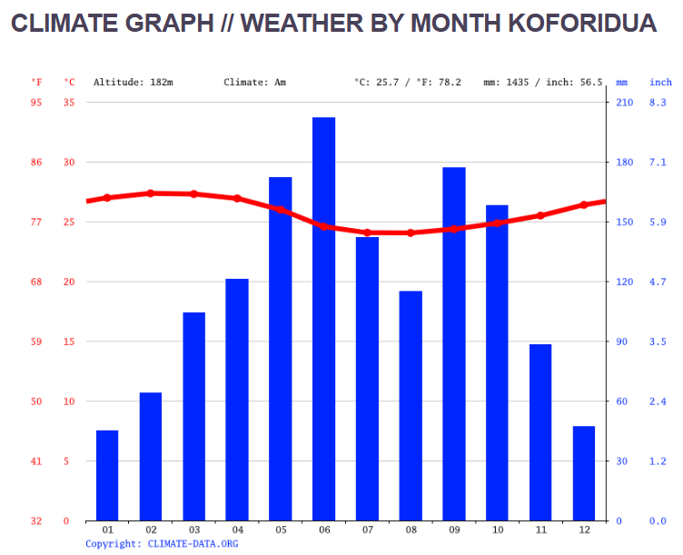
Climate Graph in Koforidua
A bar graph showing a plot of temperature and rainfall against the months in the year, with temperature displayed on the left and rainfall displayed on the right.

Slide 5
Rainfall Classification Method
Threshold-Based Methods: Traditional classification relies on threshold values of rainfall amount over specific durations to define categories like very light(0.1mm – 0.9mm), light(1.0mm – 10mm), moderate(11mm – 30mm), heavy rainfall(31mm – 70mm), very heavy(71mm – 150mm) and extremely heavy(above 150mm). These thresholds are often region-specific and based on historical data.

Slide 6

Gaps in Literature
Although a number of studies have looked at Ghana's rainfall patterns, there isn't much research specifically
on rainfall classes in Koforidua. To find regionally specific patterns and anomalies, long-term rainfall data must be thoroughly analyzed.
Furthermore, there is still a lack of research on the use of sophisticated categorization techniques like machine
learning algorithms in this situation.

Slide 7
Problem Statement
Agricultural Disruptions: Delayed or erratic rains result in crop failures and reduced yields.
Urban Flooding: Heavy and extremely heavy rainfall overwhelm drainage systems, causing economic and social disruptions.
Environmental Concerns: Shifting rainfall patterns affect forest cover and water body levels.

Slide 8
Aims and Objectives
Contribution to Policy and Planning
Enhancing the resilience of agricultural systems to rainfall variability.
Informing the design of flood-resistant urban infrastructure.
Guiding water resource management strategies in the face of climate change.

Slide 9

Methodology
Data Collection
Primary Sources: Historical meteorological data from the Ghana Meteorological Agency.
Secondary Sources: Published research and climate reports.

Slide 10
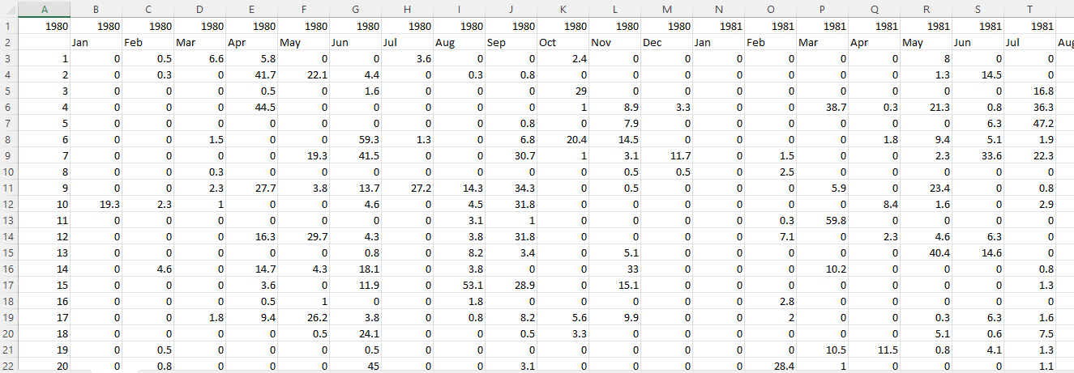
Methodology contd.
Data Cleaning
Handling Missing data: Addressing gaps in the dataset by imputation, removal, or substitution with meaningful values.
Validating Data: Cross-checking entries to ensure consistency with datasets.

Slide 11

Methodology cont.
Data Analysis
Statistical tools such as Python and MATLAB, are used to process, classify and analyze rainfall data.
Application of trend analysis techniques to identify significant shifts over time.

Slide 12
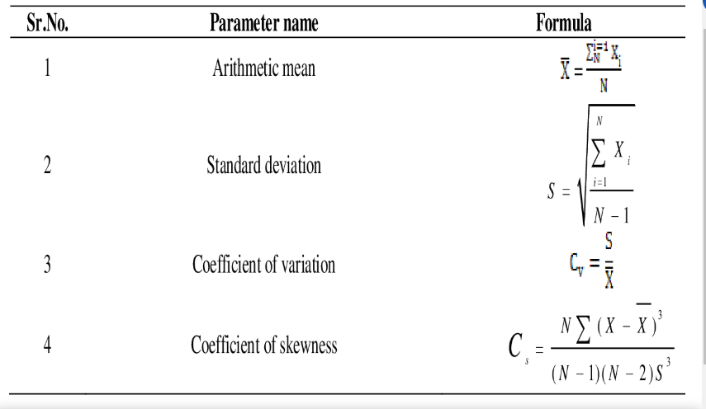
FORMULAS USED

Slide 13

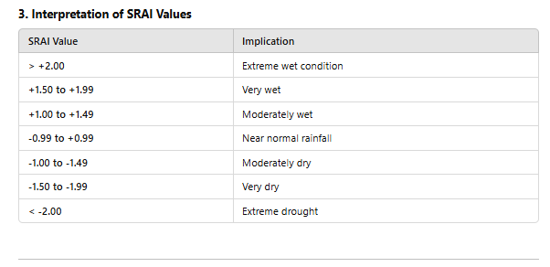
STANDARD RAINFALL ANOMALY INDEX(SRAI)

Slide 14

Methodology contd.
Sectoral Impact Assessment
Agriculture: Correlate rainfall data with crop yield statistics to assess impacts.
Urban Planning: Analyze flood frequency and drainage system performance in response to intense rainfall (heavy, very heavy and extremely heavy).

Slide 15
Expected Outcome
Agriculture: Enhanced agricultural planning and productivity through the identification of optimal planting and harvesting periods.
Water Resources: Improved water resource planning and sustainability through the identification of rainfall trends to guide the storage, distribution and conservation of water.
Urban Resilience: Guided policies to decrease challenges to existing drainage systems, leading to flooding.

Slide 16
PROJECT TIMELINE
Activity | SEP | OCT | NOV | DEC | JAN | FEB | MAR | APR | MAY | JUNE | JULY | AUG
preparing of proposal
Data Collection and Cleaning
Data Analysis
Sectoral Impact Assessment
Final report and recommendations
Notes:
This is the outline of my project timeline which will guide me on finishing in due time

Slide 17
References
Academic Journals: Journal of Applied Meteorology and Climatology, Climate Dynamics.
Climate Data. (n.d.). Eastern Region-Climate Data. Climate Data. https://en.climate-data.org/africa/ghana/eastern-region-1330/.
Weather Atlas. (n.d.). Yearly and Monthly Weather-Koforidua, Ghana. Weather Atlas https://www.weather-atlas.com/en/ghana/Koforidua-climate.
Spreadsheet [Image]. (n.d.). https://www.pexels.com/photo/a-person-holding-document-with-graph-illustration-6829513/
Programming [Image]. (n.d.). https://www.pexels.com/photo/close-up-photo-of-programming-of-codes-546819/
Spreadsheet [Image]. (n.d.). https://www.pexels.com/photo/close-up-photo-of-survey-spreadsheet-590022/

Slide 18
REFERENCES CONTD
(H.Baghel et al). (2019). Formula of Statistical Parameters. [image]. Semantic Scholar. https://www.semanticscholar.org/paper/Frequency-Analysis-of-Rainfall-Data-Using-Models-Baghel-Mittal/4bc4c969edbc6715dead11cf6887b2396567be91/figure/0

Slide 19
THE END
THANK YOU

